Slide 1
Lo bueno
lo malo y
lo feo
de la
Inteligencia
Artificial
en Medicina
Domingo Mery
Ciencia de la Computación
Ingeniería UC
iHealth
07/08/23

Slide 2

Lo bueno
lo malo y
lo feo
de la
Inteligencia
Artificial
en Medicina
Domingo Mery
Ciencia de la Computación
Ingeniería UC
iHealth
07/08/23

Slide 3
Lo bueno…
La inteligencia artificial
…es una gran oportunidad

Slide 4
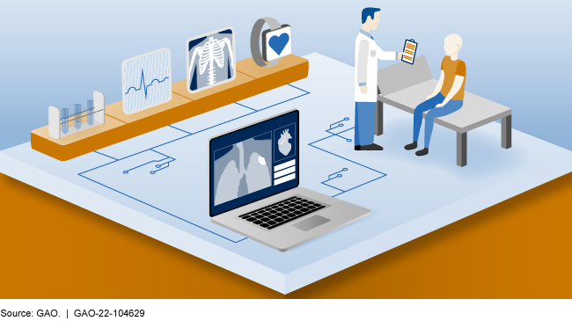
Mejoras en el diagnóstico
https://www.gao.gov/blog/machine-learnings-potential-improve-medical-diagnosis

Slide 5

Detección temprana de enfermedades
https://www.indushealthplus.com/cancer-early-detection-equals-better-diagnosis.html

Slide 6
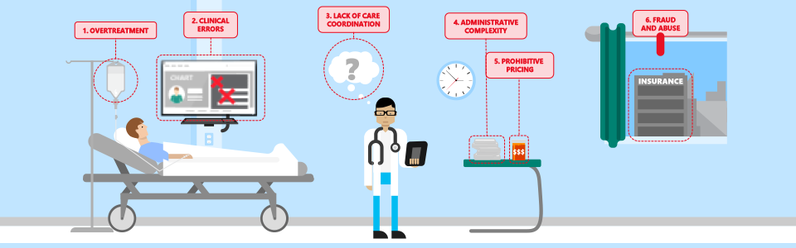
Mayor eficiencia en procedimientos médicos
https://www.microsoft.com/en-us/industry/blog/healthcare/2017/03/28/diagnosing-healthcare-spending-the-top-6-ways-to-increase-efficiency-in-healthcare/

Slide 7
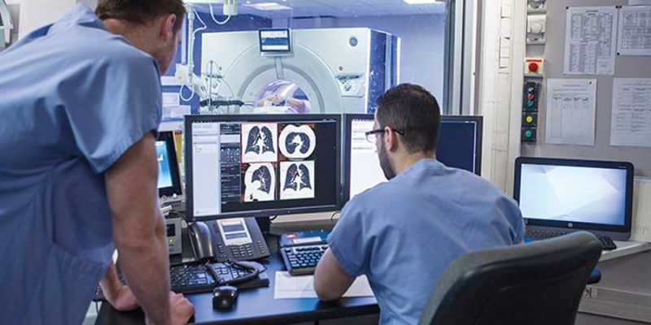
Apoyo en el diagnóstico basados en imágenes
https://www.healthcareoutlook.net/top-10-ai-based-medical-diagnostic-tools-to-try-in-2022/

Slide 8
Nuevas aplicaciones…
Equipment-integrated AI software
The thought of integrating image recognition AI software straightforwardly into imaging tools (e.g. MRI or CT scanners) is advancing momentum as it would help the automation of medical image analysis. In addition, it prevents problems with connectivity as no cloud entrance is requisite.
Access to patient data and recommended treatment procedure
Nowadays, AI algorithms only have the right of entry to AI medical diagnostics. As such, the situation and medical history of patients are unidentified to the AI software during the analytical procedure. Because of this restriction, the software is constrained to locating abnormalities, providing quantitative data, and, in a few cases, assessing the danger of disease.
Imaging tools neutrality
The installation of AI software for the medical diagnostic tool can sometimes symbolize an important change to hospitals’ and radiologists’ workflow. Although many medical centers welcome the thought of getting decision support through Artificial Intelligence, the reality of going through the installation procedure can be daunting adequate to discourage some hospitals.
Reduced neural network density
The architecture of AI algorithms used in medical image analysis today tends to be complicated, which extends the growth procedure and increases the computing power required to use the software. Companies developing the software must make sure that their computing power is enough to hold customers’ actions on their servers.
All-encompassing training data
A chief technical and business benefit lies in the exhibition of achievement in dealing with a broad range of patient demographics as it widens the software’s applicability. Artificial Intelligence software must work uniformly well for males and females, and different ethnicities, for instance.
Multiple disease applications
Another significant improvement will be to apply AI algorithms to numerous diseases. At present, many AI-medical diagnostics tools can only spot a limited range of pathologies. Their value in radiology practices is hence restricted as the algorithms may overlook or misinterpret signs of disease.
Combining data sources through sensor fusion
Radiologists have a series of imaging methods at their disposal and may require utilizing more than one to spot signs of disease. For instance, X-ray and CT scanning are both used to spot respiratory diseases. X-rays are cheaper and faster, but CT scanning provides more information about lesion pathology.
Remote Patient Monitoring System
Data collected is not of much use until it is analyzed precisely. The time-lapse between data collected from patients and analysis can take time. Though, delays or errors in data study can have harsh health impacts. Remote patient monitoring solutions resolve problems by using patient monitoring systems.
Custom EHR/ EMR Solutions
EHR/EMR system development services construct robust and realistic solutions that assist in eliminating redundancy and piles of papers containing patient information. Its electronic medical record (EMR) systems assist providers to work professionally and drive improved medical, financial, and operational outcomes.
mHealth
Healthcare mobile app development is one of the most hopeful custom healthcare software development services. As virtual health is paving its way to a patient and provider’s daily process and workflows, a mhealth system platform’s development becomes necessary.
https://www.healthcareoutlook.net/top-10-ai-based-medical-diagnostic-tools-to-try-in-2022/

Slide 9
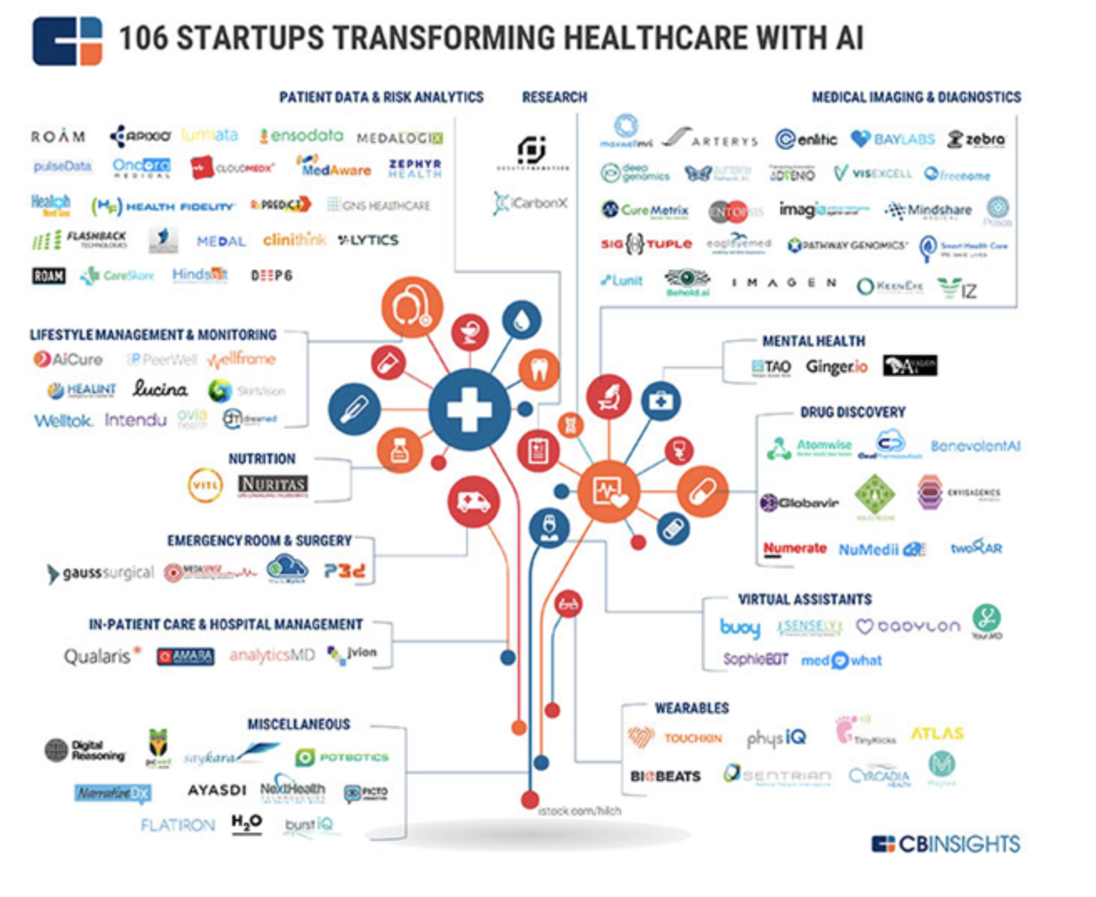
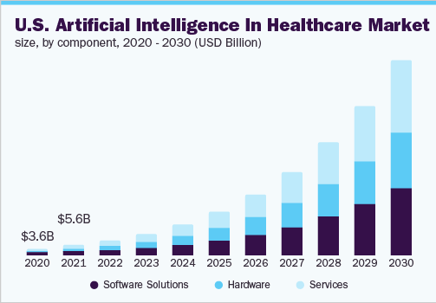
Nuevos startups…
https://www.grandviewresearch.com/industry-analysis/artificial-intelligence-ai-healthcare-market

Slide 10
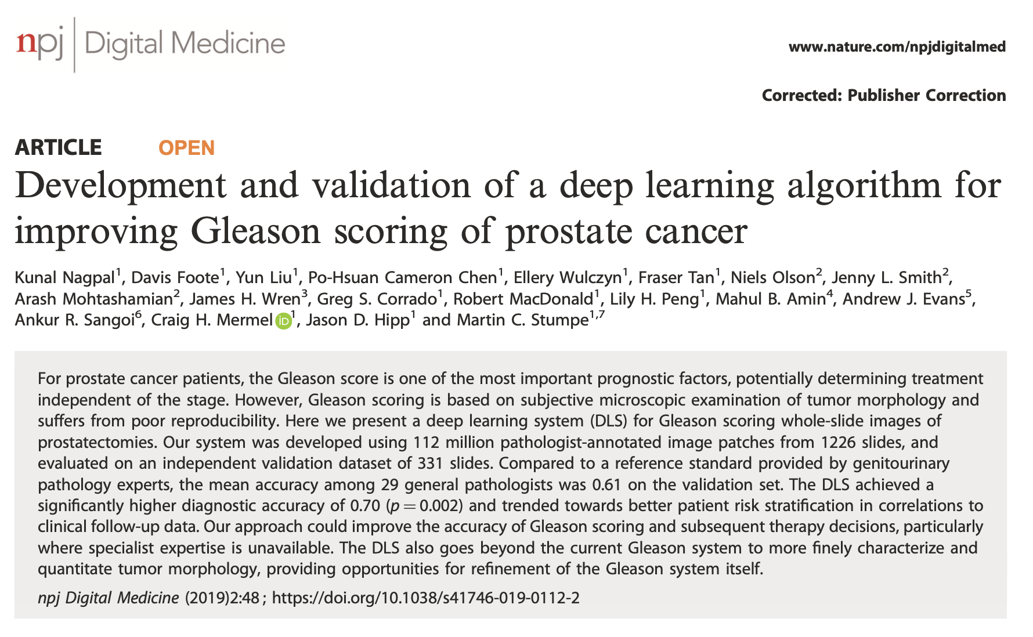
Nuevas investigaciones…

Slide 11
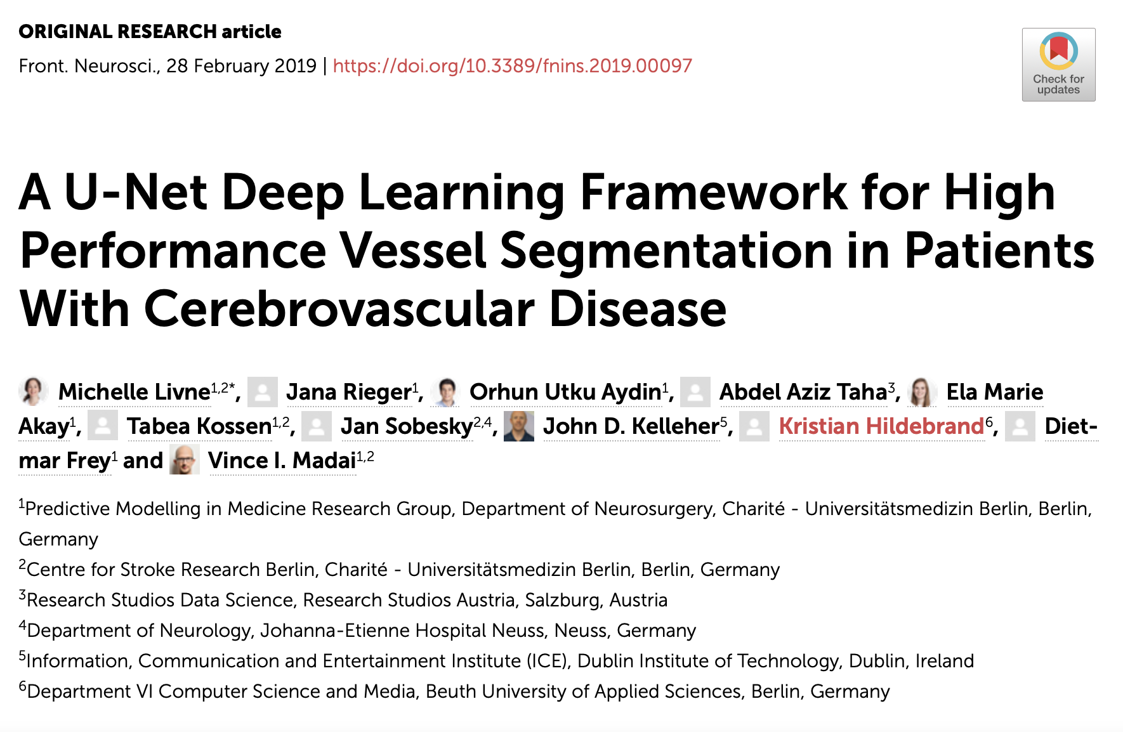
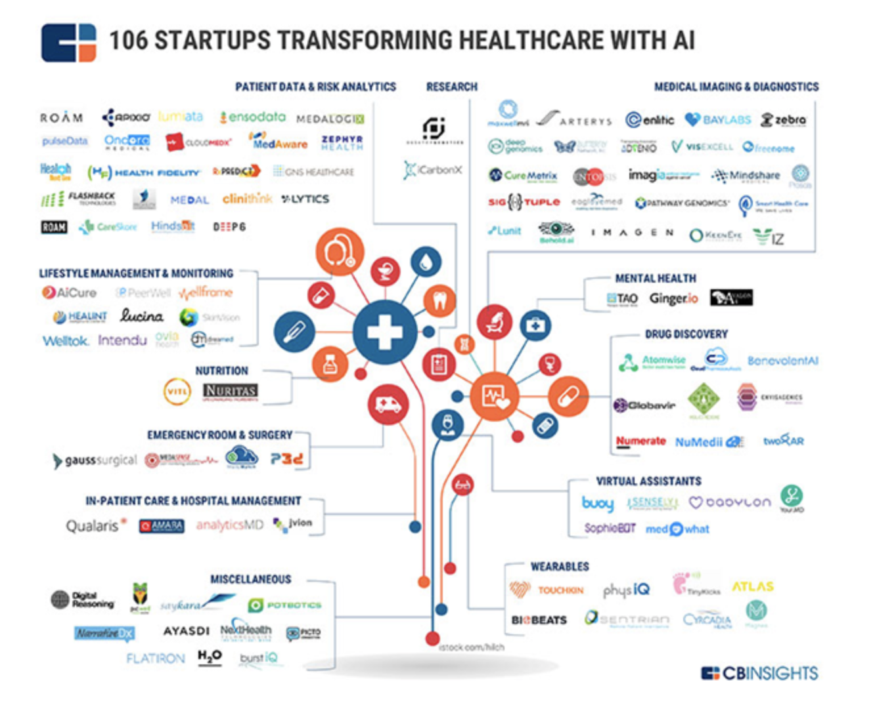
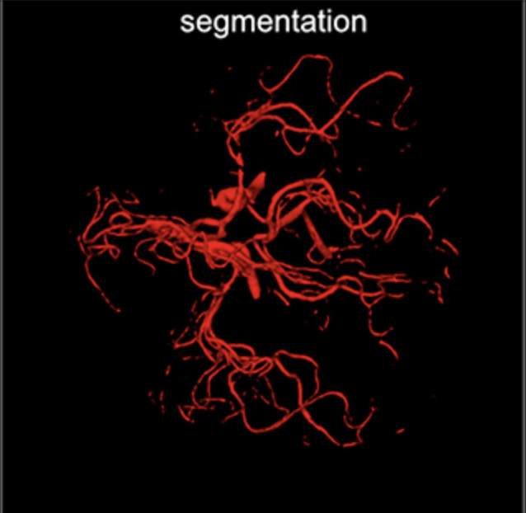

Slide 12
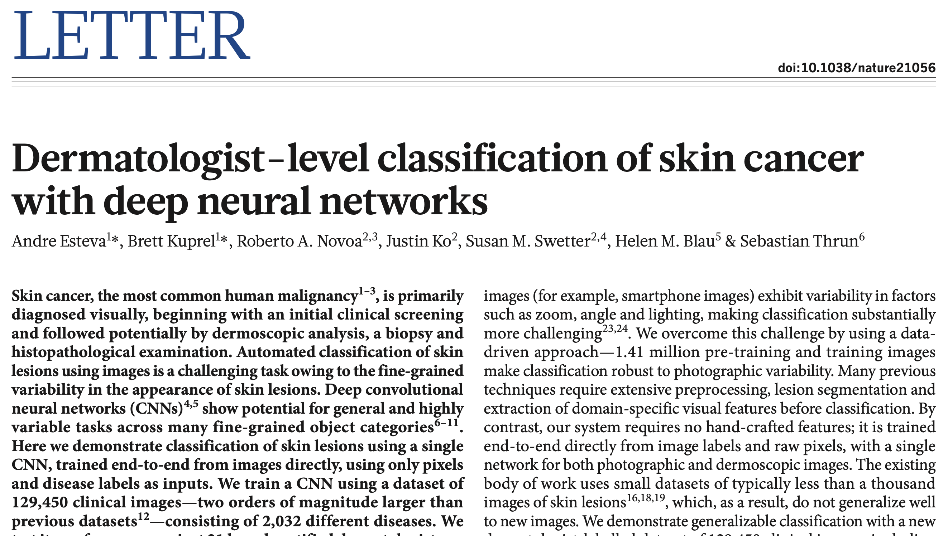

Slide 13
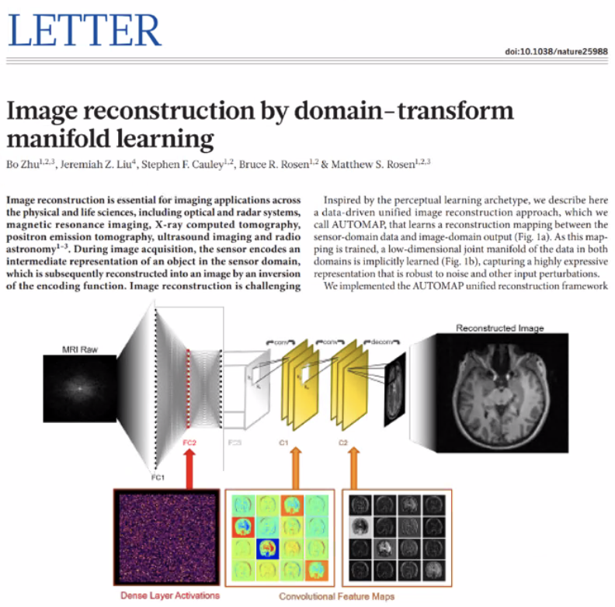

Slide 14
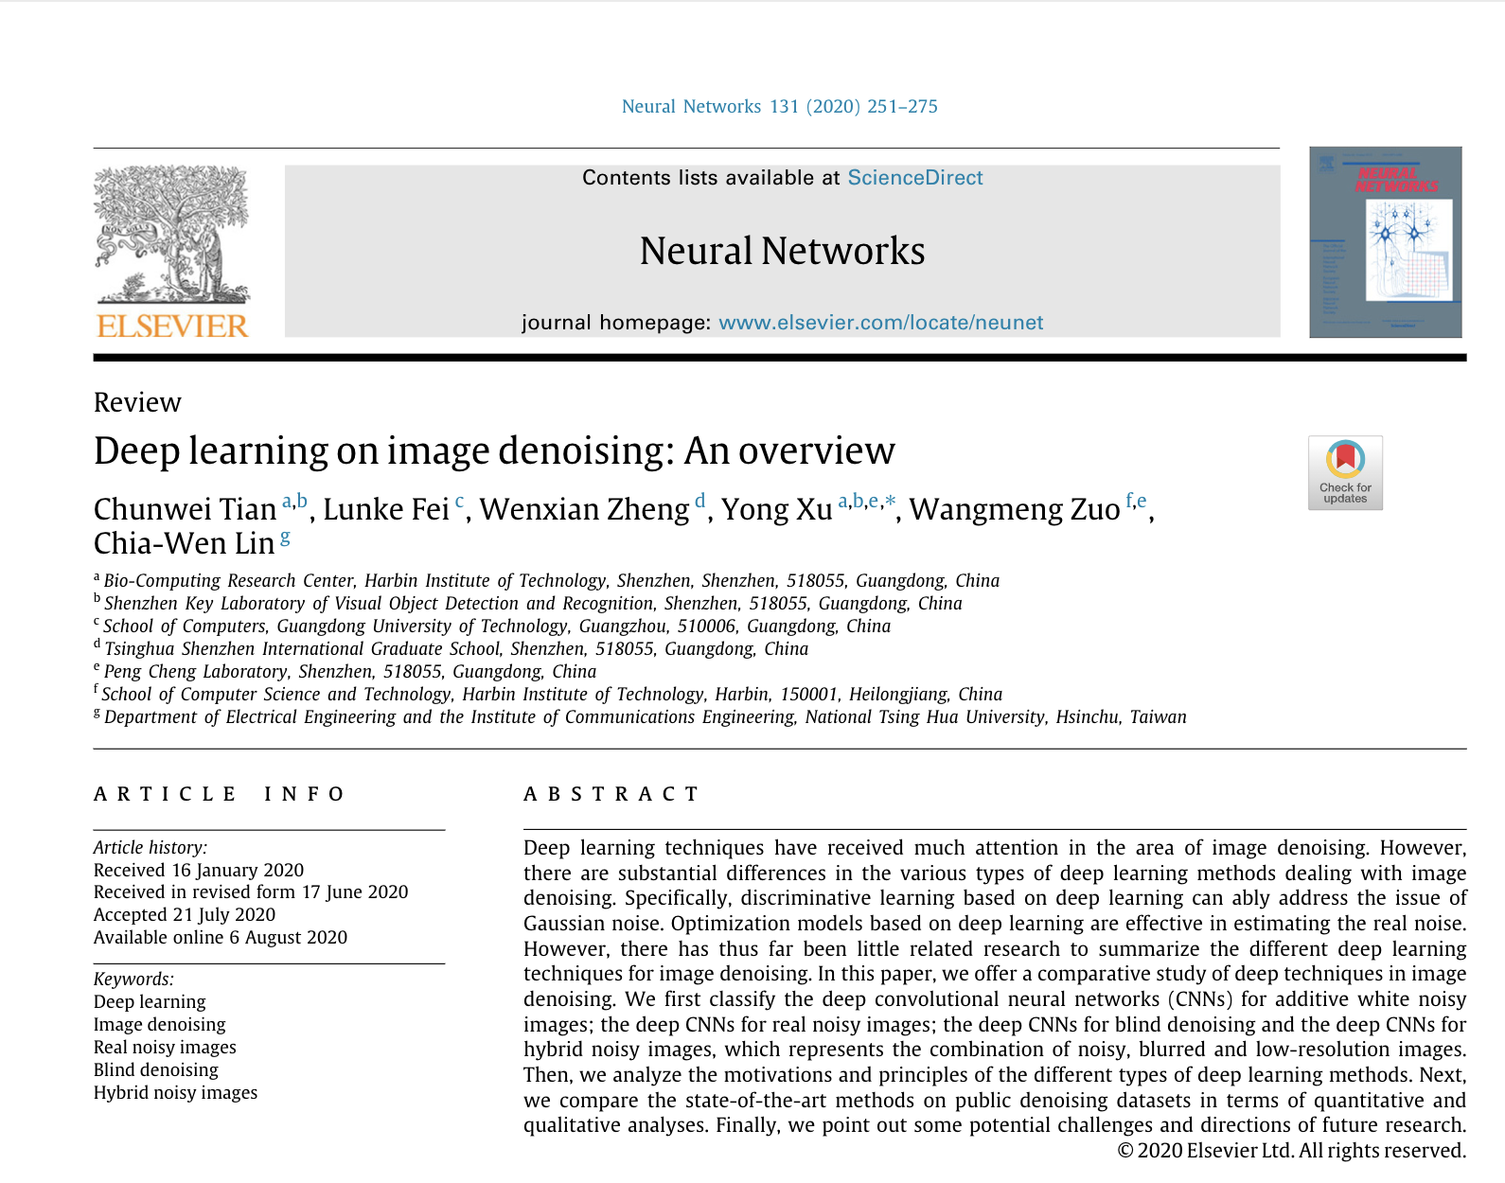

Slide 15
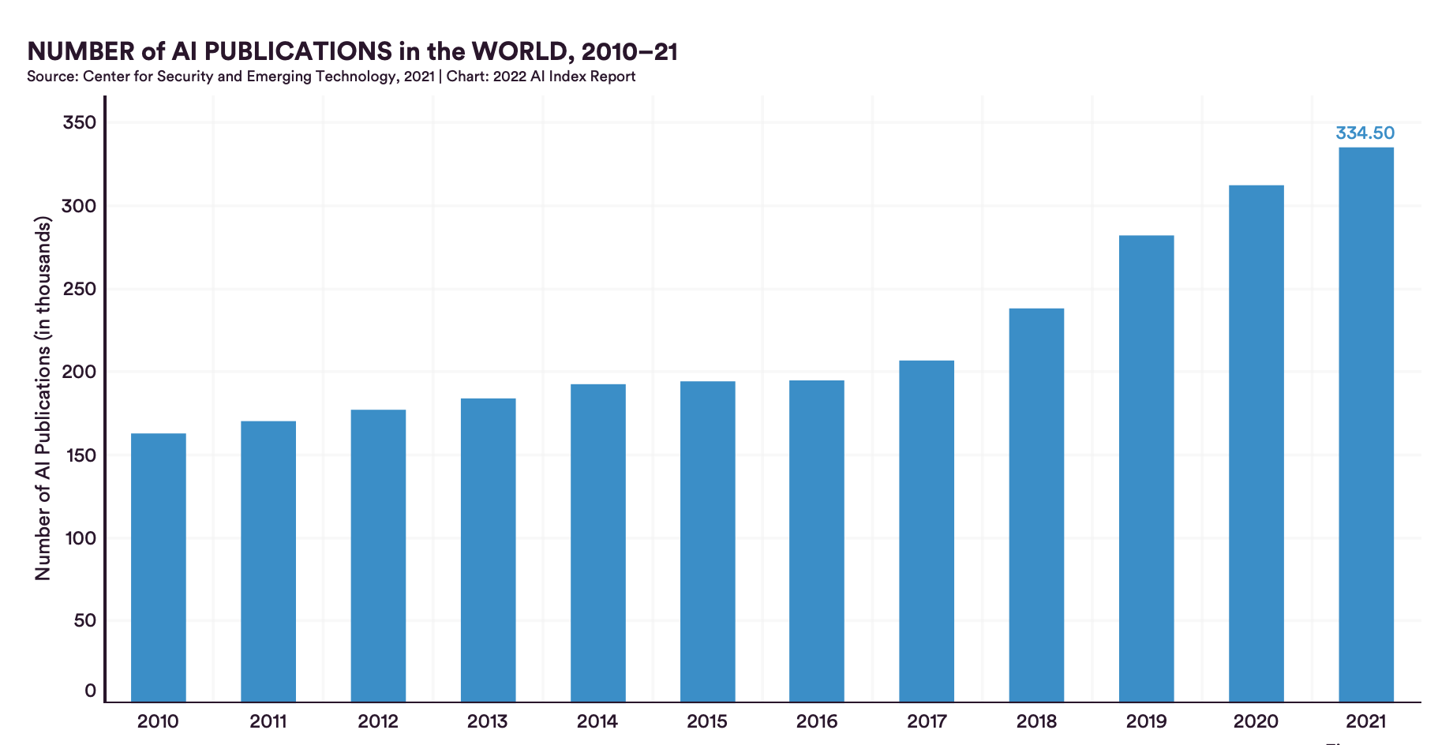
AI Index Rerpot 2022

Slide 16
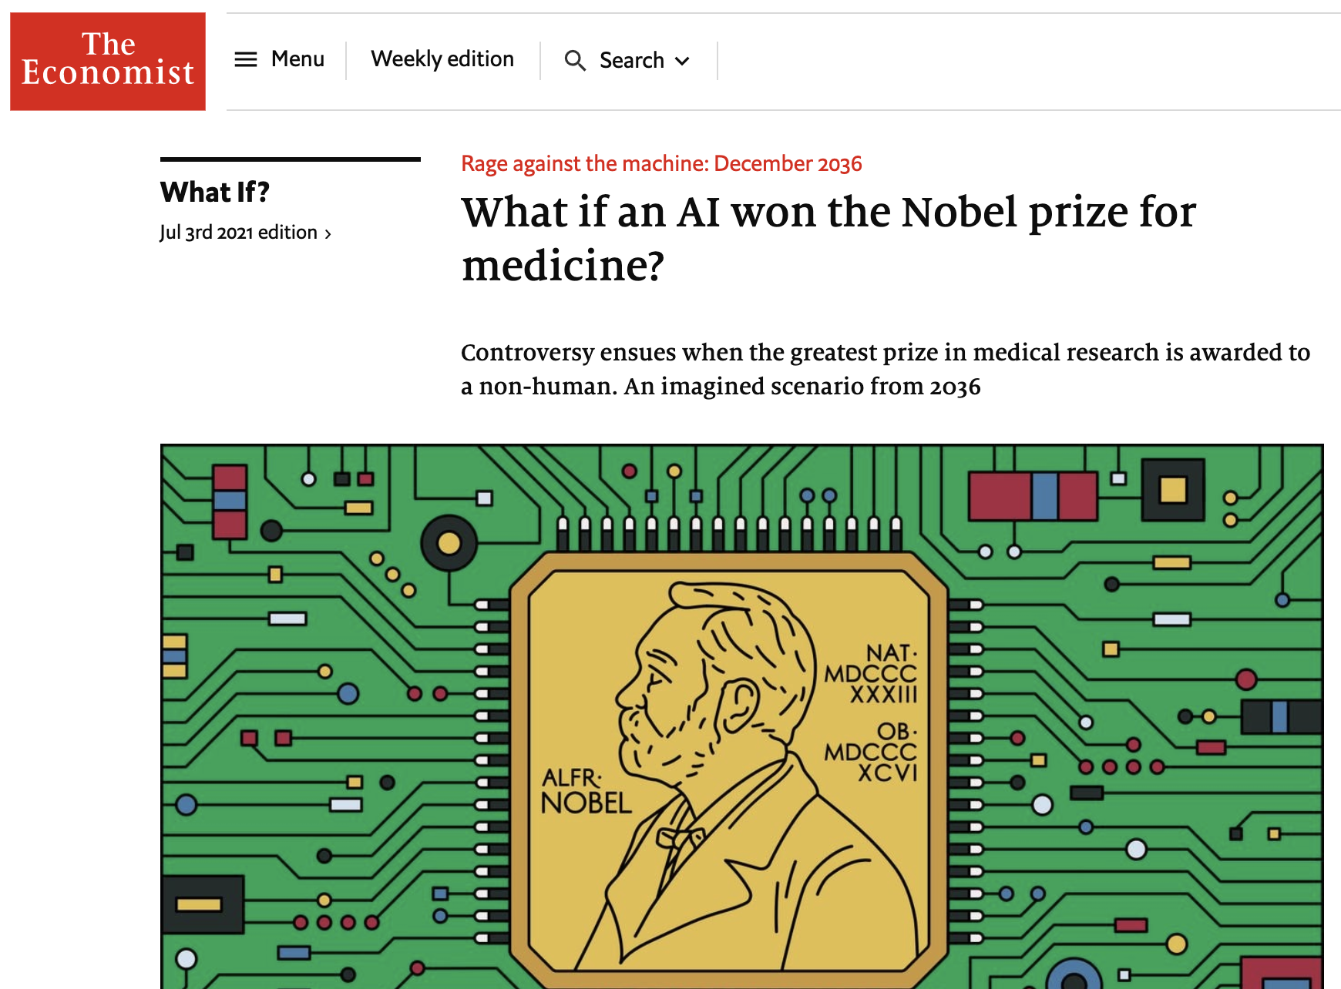
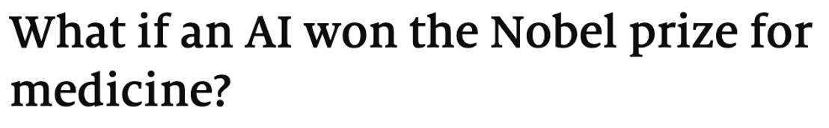
https://www.economist.com/what-if/2021/07/03/what-if-an-ai-wins-the-nobel-prize-for-medicine

Slide 17
Lo malo…
Se sabe poco de
la inteligencia artificial
… y creemos que sabemos mucho

Slide 18
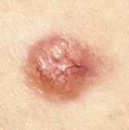
Mala Generalización
Los resultados presentados en muchos artículos que funcionan bien en un conjunto de datos específico pueden variar significativamente en otros conjuntos de datos.
Imagen del
Hospital A
Deep
Learning
‘Melanoma´

Slide 19

Mala Generalización
Los resultados presentados en muchos artículos que funcionan bien en un conjunto de datos específico pueden variar significativamente en otros conjuntos de datos.
Imagen del
Hospital B
Deep
Learning
‘Carcinoma´

Slide 20



No hay buenas explicaciones
Faltan modelos explicables que puedan mostrar el significado semántico de los diagnósticos basados en inteligencia artificial.
Deep
Learning
Why ?
‘Melanoma´

Slide 21

Faltan buenas bases de datos
Los datos de entrenamiento y prueba no son suficientes.
Necesitamos grandes conjuntos de datos (con diagnósticos reales) con clases equilibradas, que representen plenamente a todos los grupos demográficos.

Slide 22
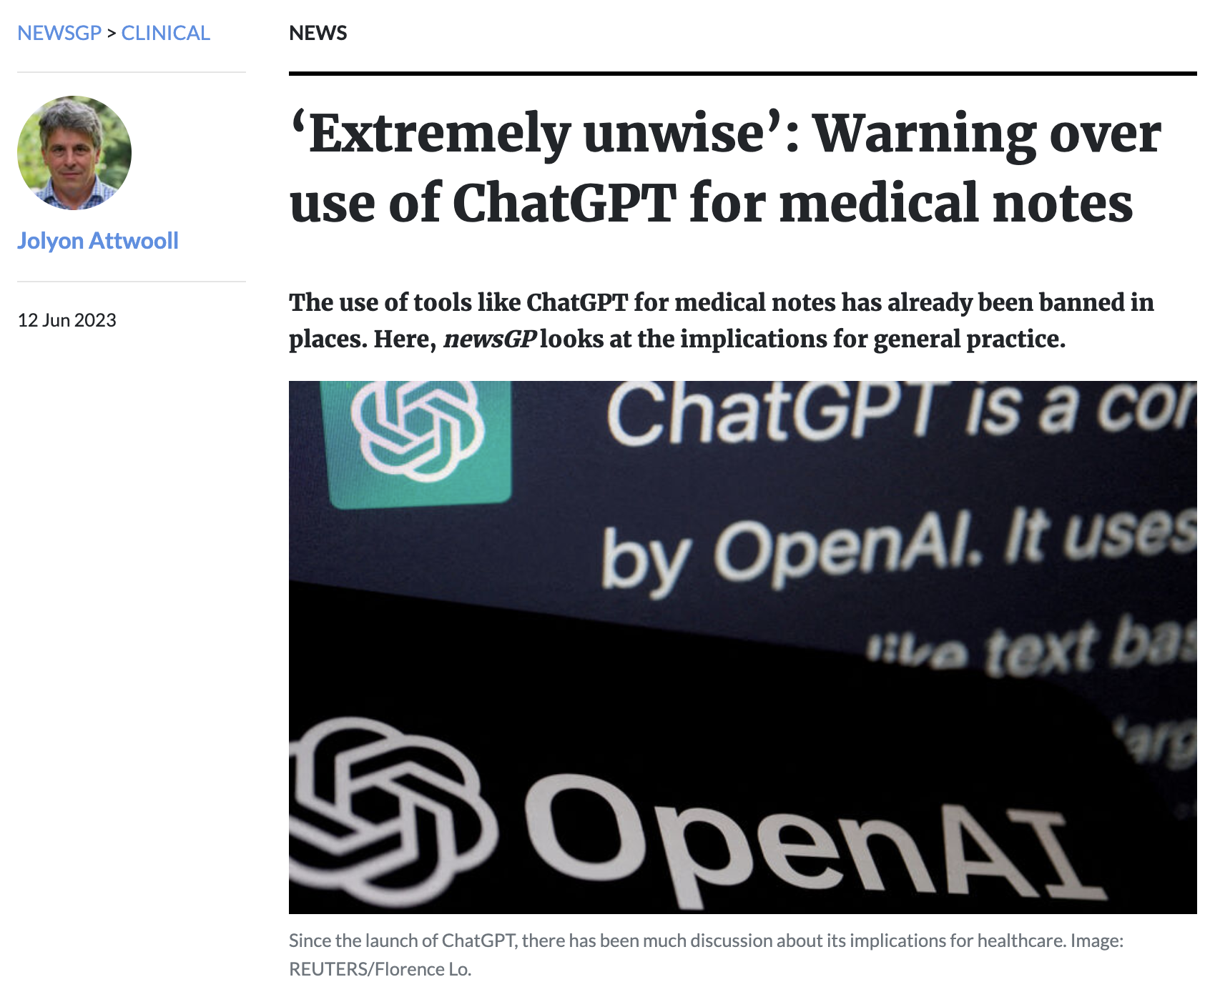
No sabemos cómo
impactará ChatGPT
El director ejecutivo del Servicio de Salud Metropolitano Sur de Perth envió el siguiente mensaje al personal después de que las notas médicas recopiladas utilizando ChatGPT se cargaran en los sistemas de registro de pacientes.
“… no hay ninguna garantía de confidencialidad del paciente cuando se utiliza tecnología bot de IA, como ChatGPT, ni comprendemos plenamente los riesgos de seguridad…
Por esta razón, el uso de la tecnología de IA, incluido ChatGPT, para actividades relacionadas con el trabajo que incluyan cualquier información de pacientes o de servicios de salud potencialmente sensibles debe cesar inmediatamente".
https://www1.racgp.org.au/newsgp/clinical/extremely-unwise-warning-over-use-of-chatgpt-for-m

Slide 23

No sabemos
cuáles
serán las
consecuencias
de la IA
https://www.newscientist.com/article/mg25934500-700-unions-strike-to-save-the-world-from-bad-tv-and-movies/

Slide 24
Lo feo
Puede haber un mal uso de …
la inteligencia artificial

Slide 25
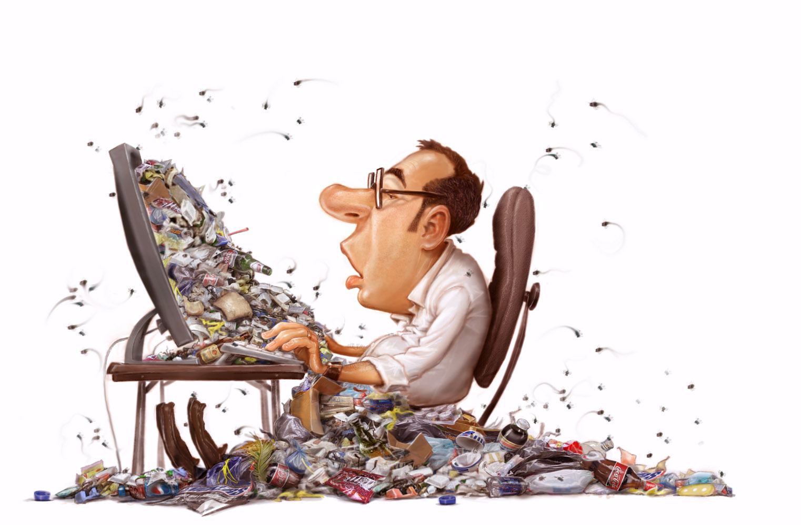
GIGO: Garbage in = Garbage out
Si entrenamos los modelos con datos de mala calidad…
…no esperemos resultados de buena calidad
http://getgareth.github.io/2016/12/27/Garbage-in,-garbage-out.-A-developer-story.html

Slide 26
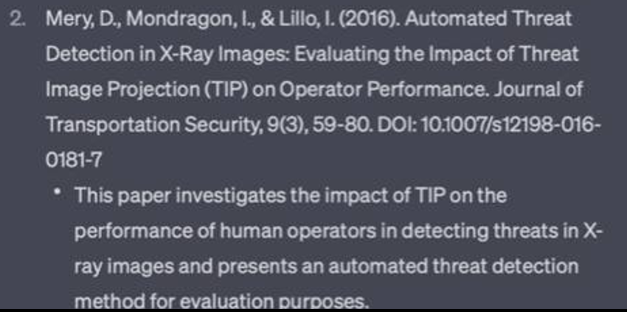
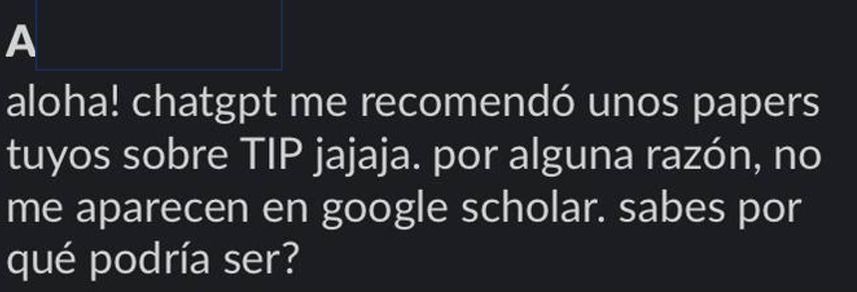
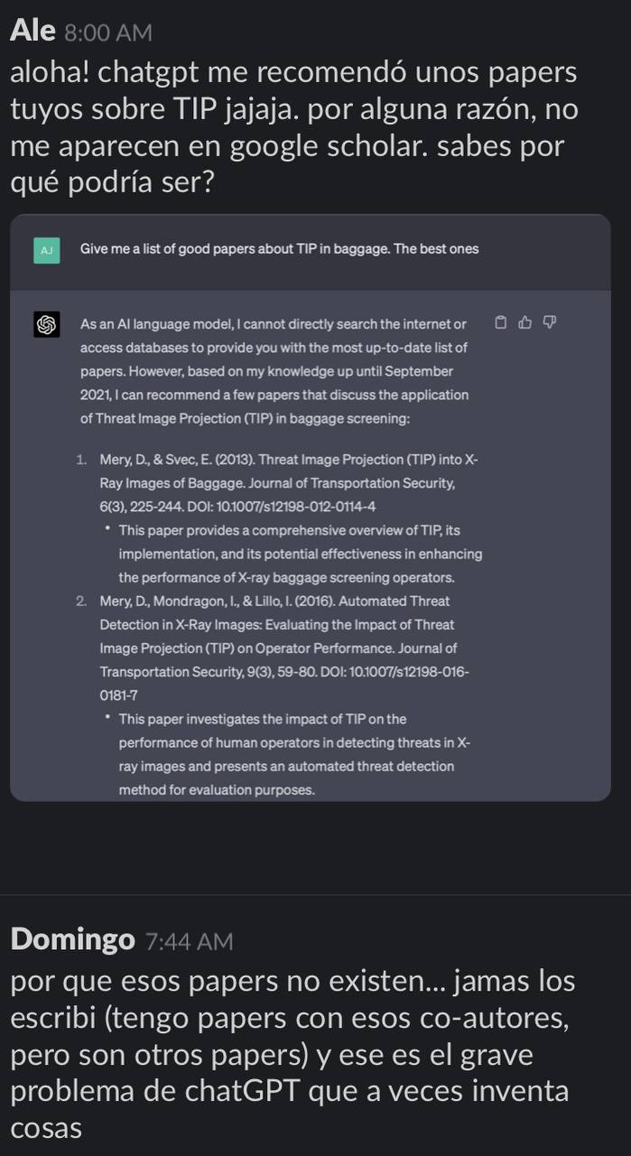
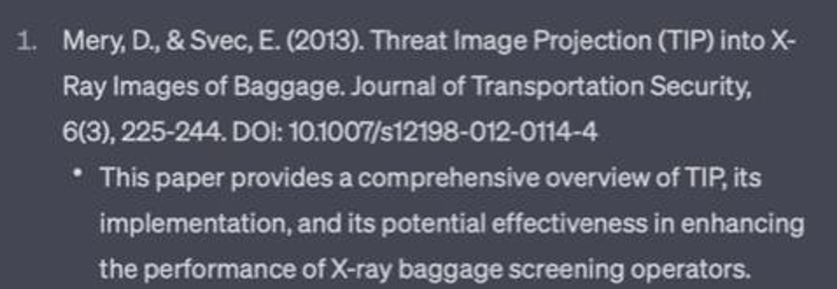

Mal uso de ChatGPT
Estudiante A. preguntándole a ChatGPT

Slide 27
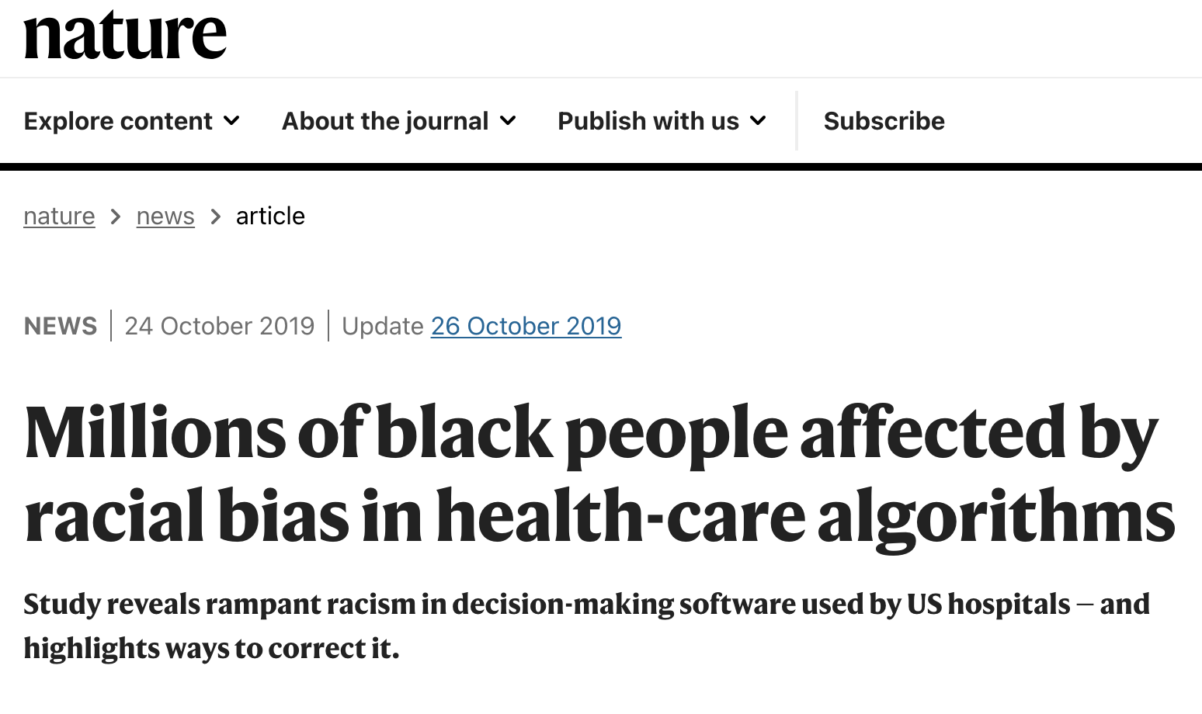
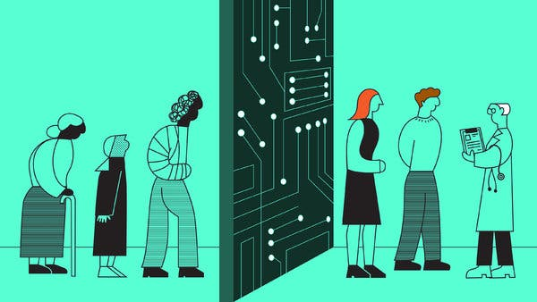
Uso de modelos sesgados
https://www.nature.com/articles/d41586-019-03228-6
https://www.nytimes.com/2019/01/31/opinion/ai-bias-healthcare.html

Slide 28
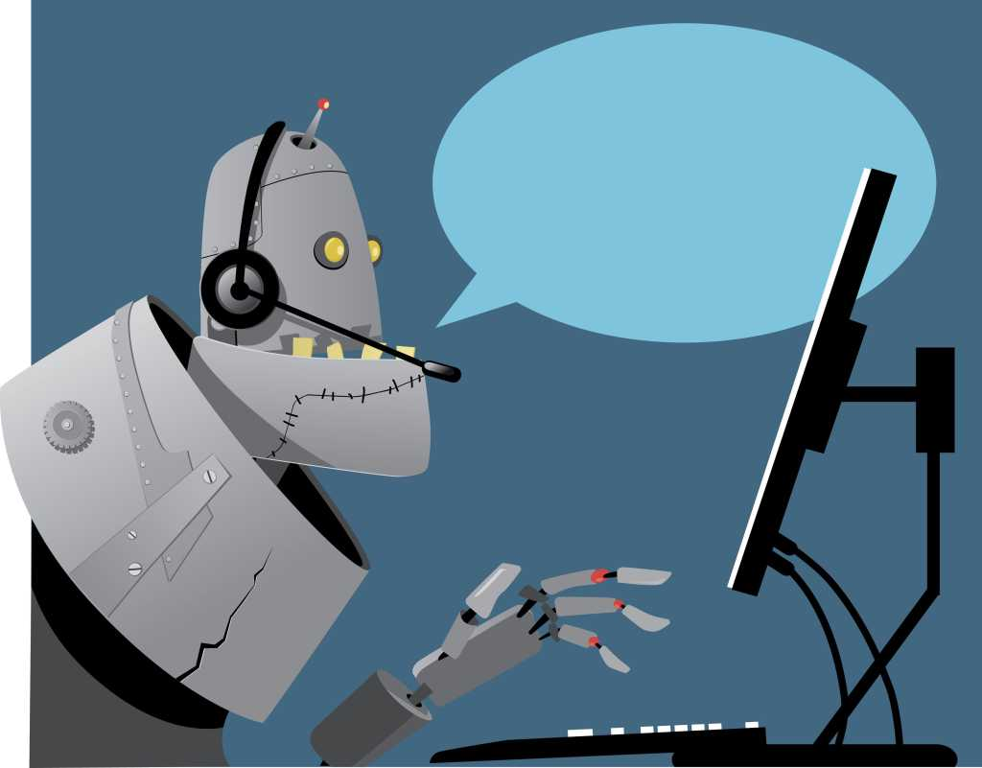
Falta de humanidad,
falta de empatía
USTED,
SE HA COMUNICADO CON
EL CENTRO MEDICO HUICHINI
POR FAVOR DIGA SU RUT…
. . .
EL RUT QUE USTED HA
DICHO NO EXISTE
POR FAVOR DIGA SU
RUT
https://www.cio.com/article/228205/bots-and-ai-continue-their-march-toward-call-center-obliteration.html

Slide 29
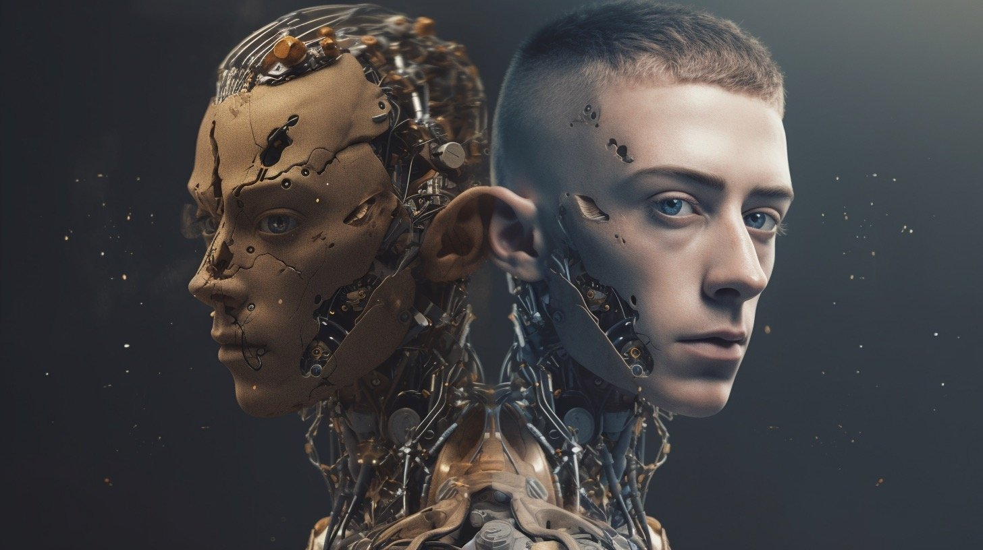
Falta de privacidad
https://www.claytoncountyregister.com/news2/ai-federated-learning-the-solution-to-data-privacy-concerns-in-machine-learning/1237/

Slide 30
Bueno… ¿y qué hacemos?
Ética
Ética
Ética
(en el uso)
Ética
Ética
Ética
Ética
Ética
(en el desarrollo)
Ética
Ética
Ética
Ética
(en la enseñanza)

Slide 31

CONCLUSIÓN
La Inteligencia Artificial en Medicina es algo difícil…
MUCHAS GRACIAS
…pero ¿quién dijo que lo difícil es imposible?

